Slide 1
sc1015 Mini Project
Used Car Price Predictor
FCEE Group 8
Ryan Lau Rui Yang (U2321713K)
Xu Shuwei (U2321134D)
Chua Sherilyn (U2322437D)

Slide 2

Introduction
Given how significant of an investment a car can be, most would want to maximise the price they sell their car for.
However, there are many factors that can affect the price of a used car.
How does one decide on a suitable price?
USED CAR PRICE PREDICTOR!!!

Slide 3
Problem Definition
Prediction
Model
Is it possible to predict the price of a used car based on its different characteristics.
What would the best model for prediction be?

Slide 4
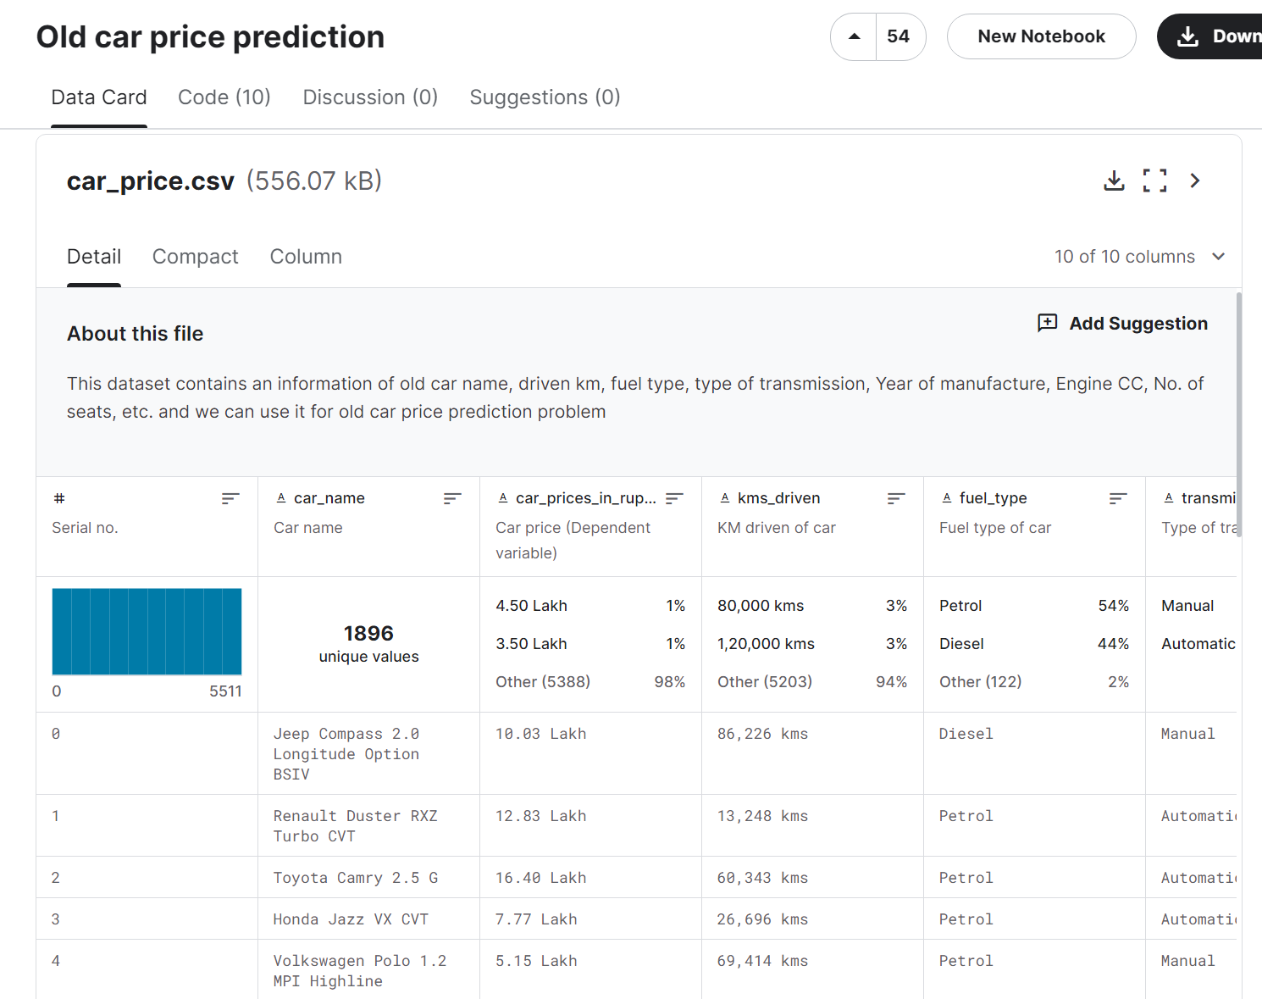
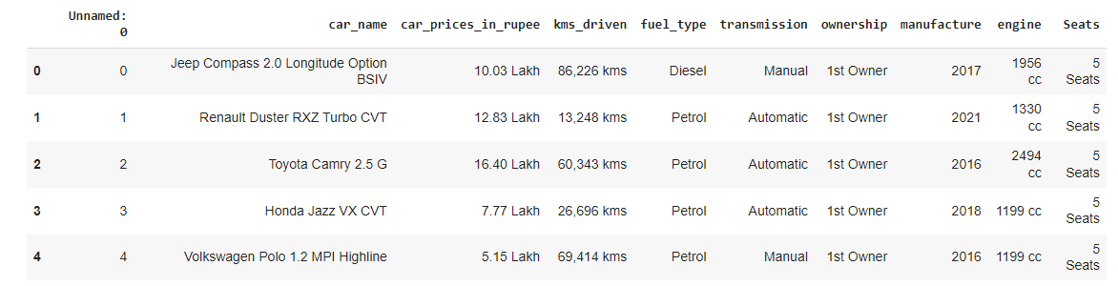
Data Set
https://www.kaggle.com/datasets/milanvaddoriya/old-car-price-prediction/data

Slide 5
Data Cleaning
1. Data type conversion
2. Splitting brand and model
3. Conversion of currency
4. Standardise column headers to lowercase (Seats)
5. Removing unnecessary columns
6. Hot-encoding categorical variables

Slide 6
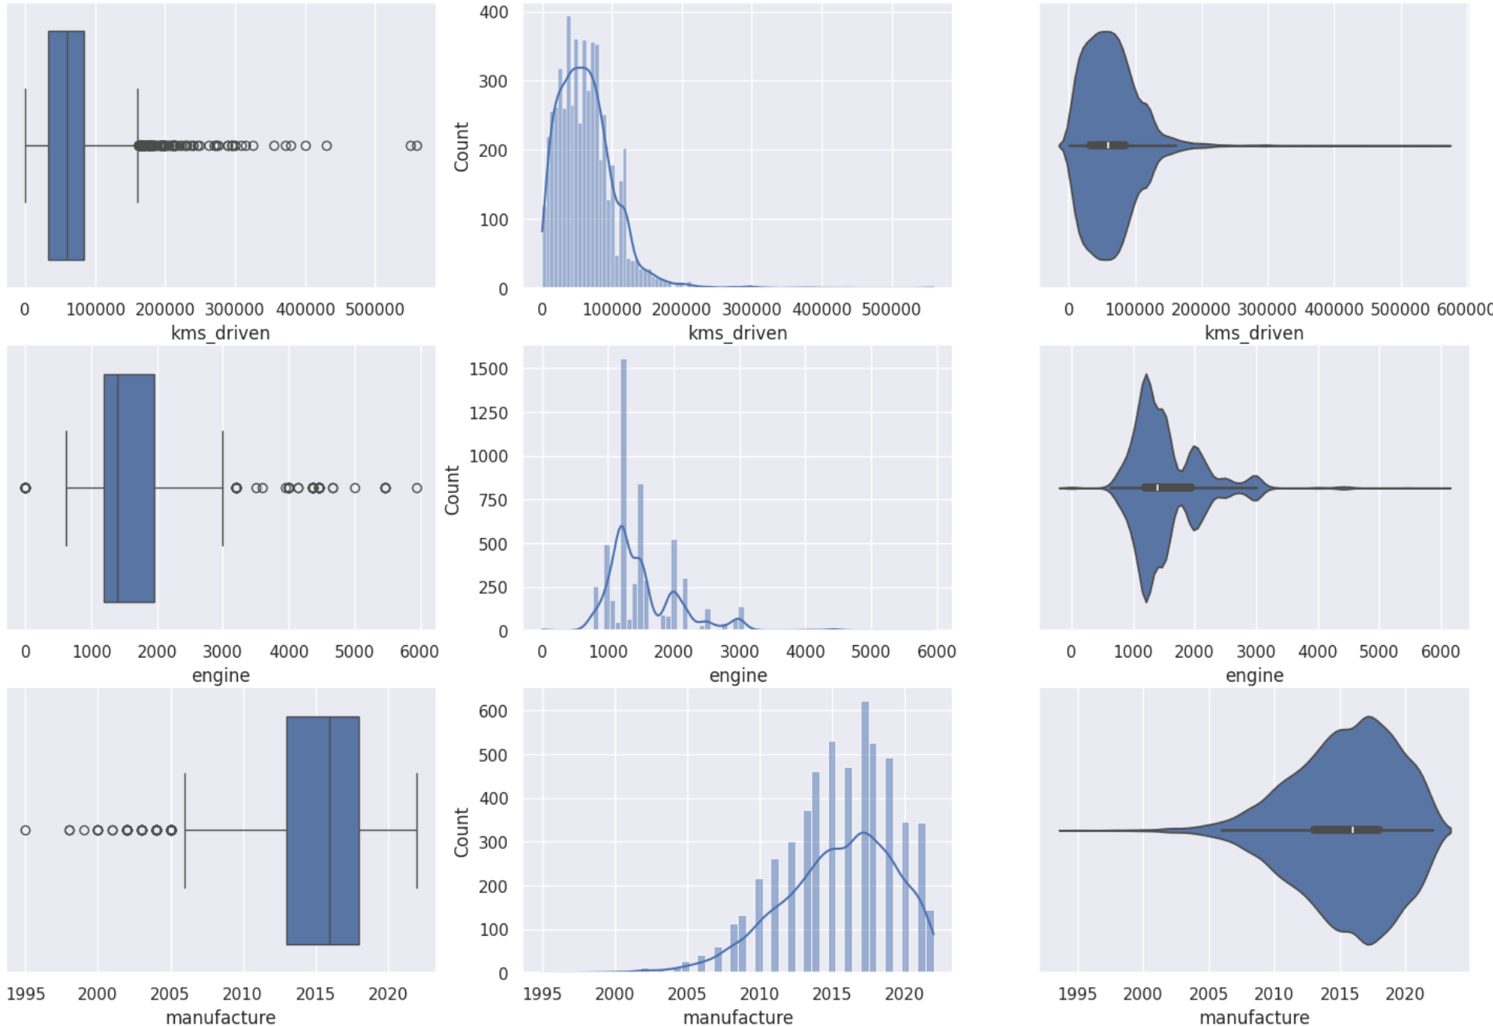
Exploratory Analysis
kms_driven
engine
manufacture
Right Skewed Distribution
Right Skewed Distribution
Left Skewed Distribution

Slide 7
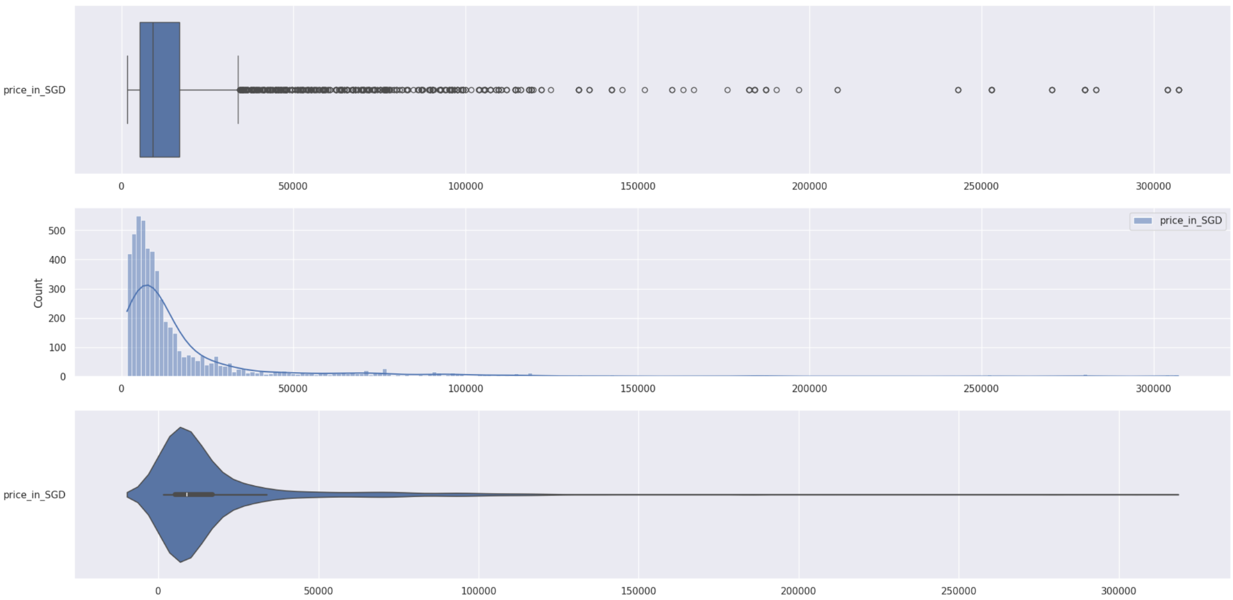
Exploratory Analysis
Distribution of Price
Right Skewed Distribution

Slide 8
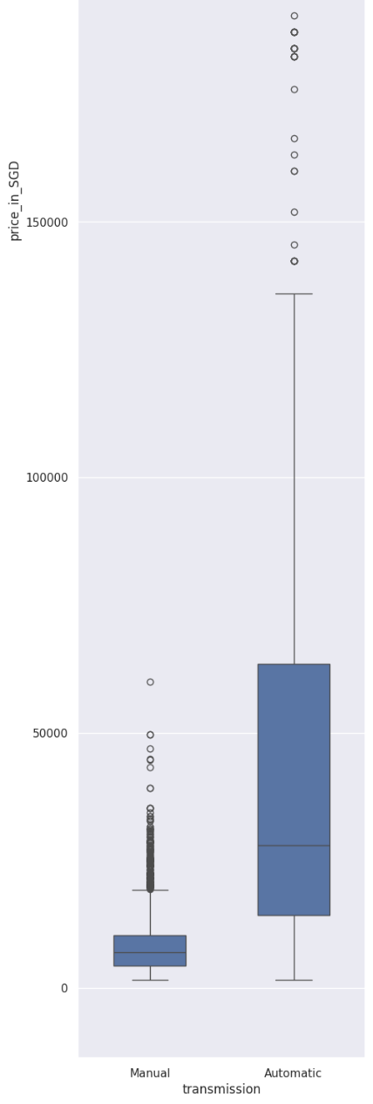
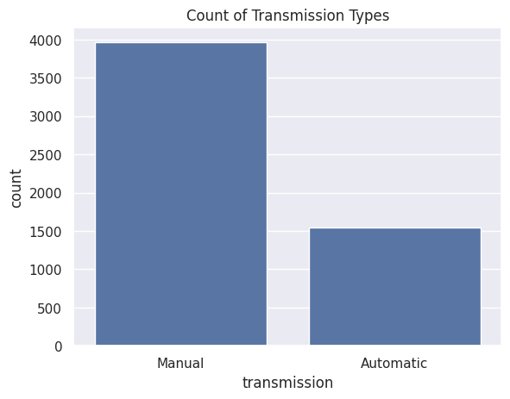
Exploratory Analysis

Slide 9
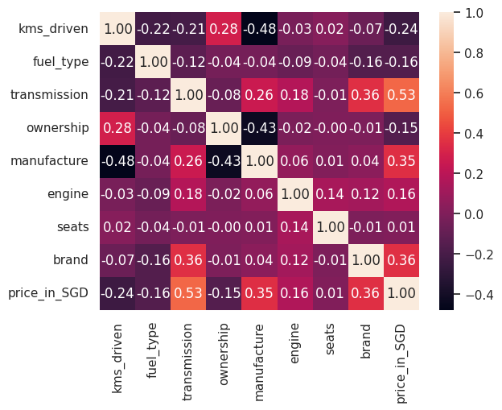
Correlation

Slide 10
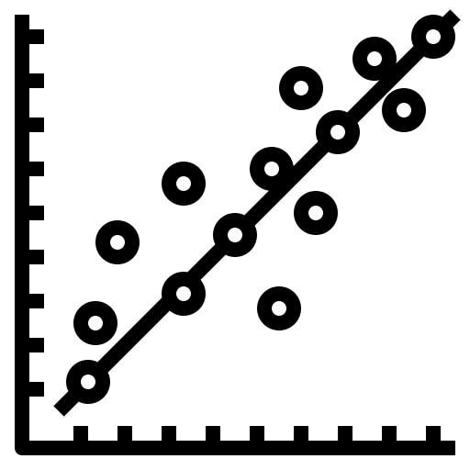

Three Models
Linear Regression
Decision Tree Regressor
Extreme Gradient Boosting

Slide 11
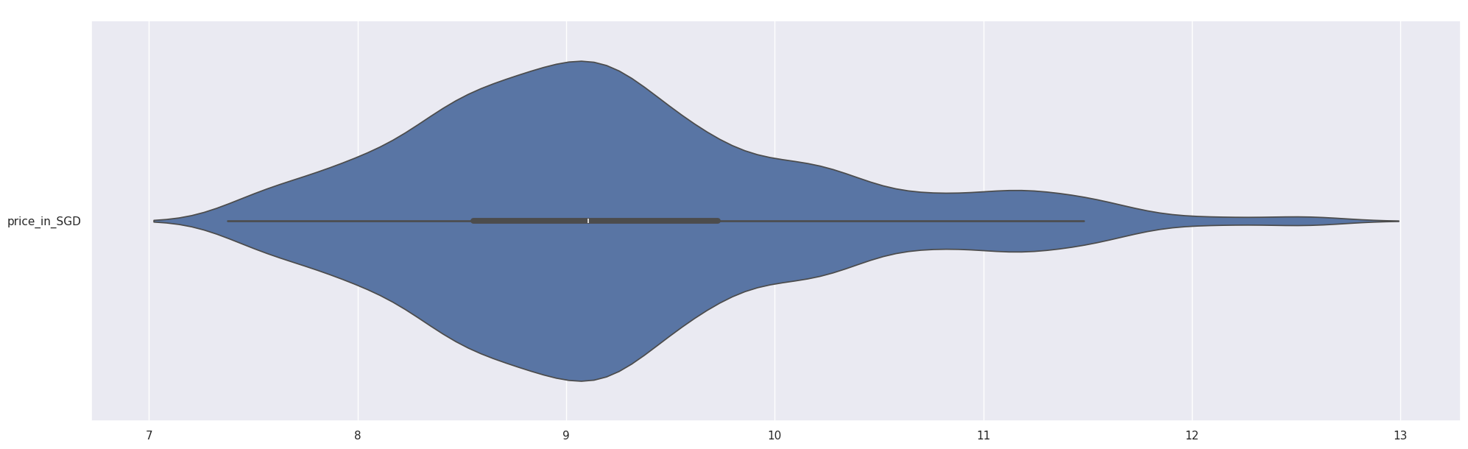
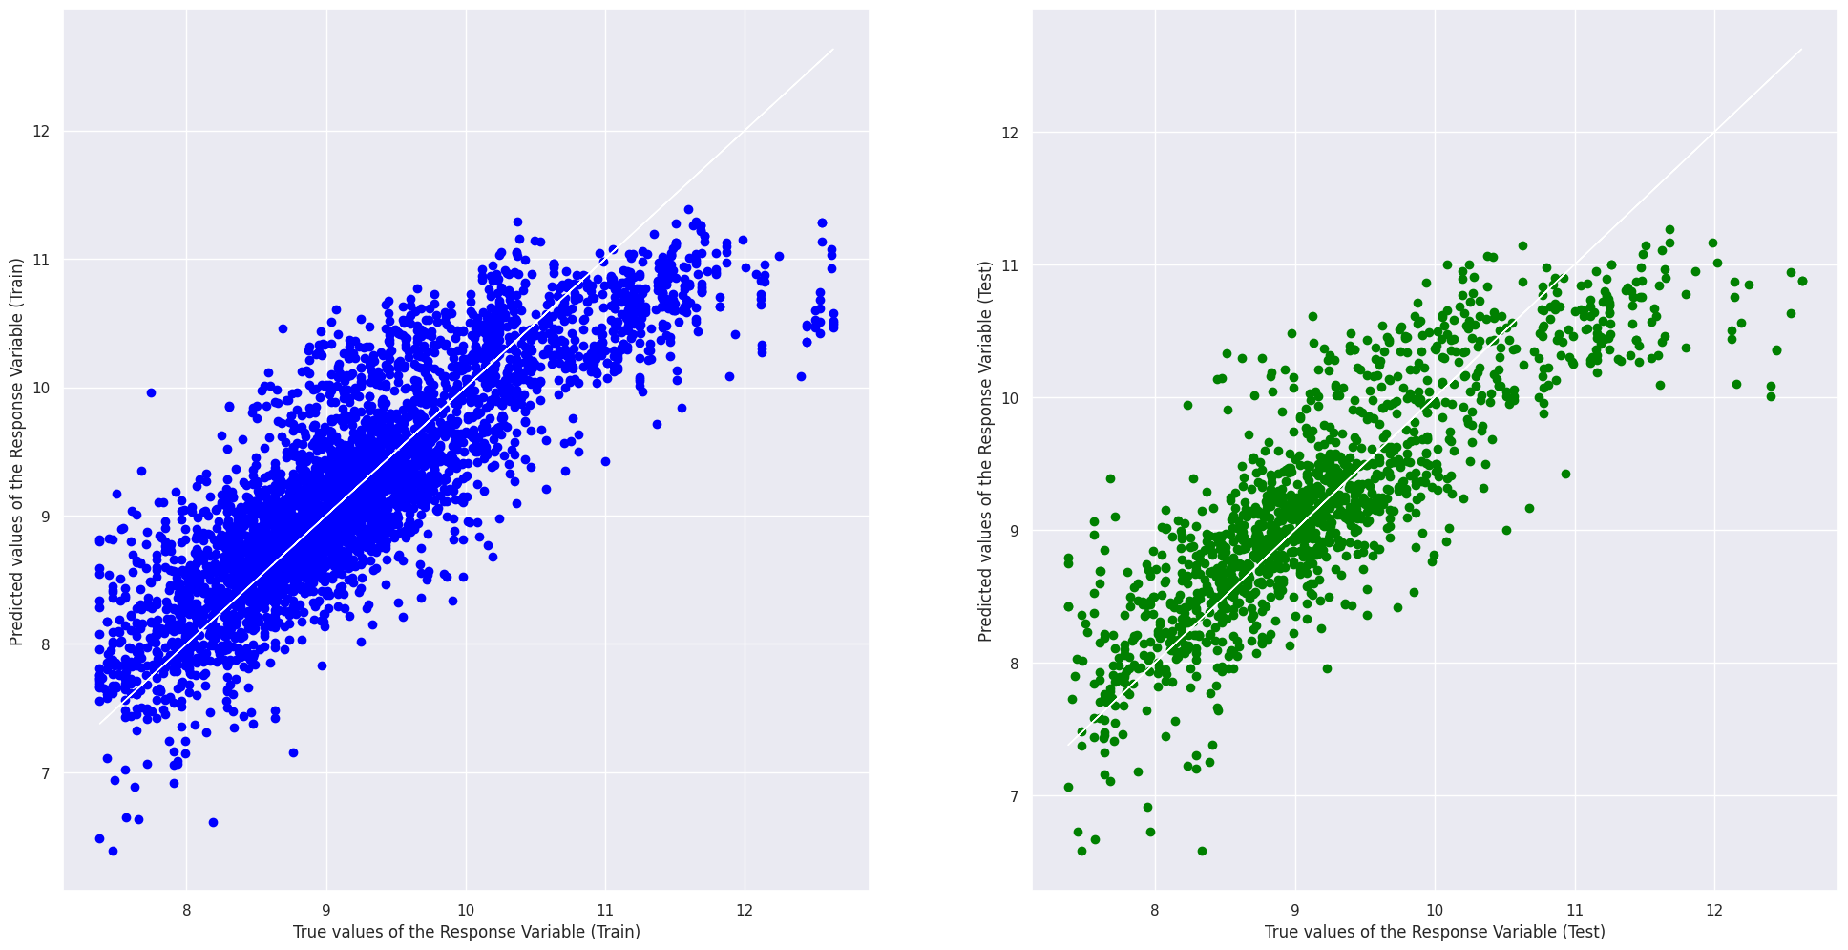
Linear regression
Take the log of price reduce skewness prior to linear regression
Most variables are categorical, with moderate linear correlation to price
Although linear regression was done, we can see that it is the worst out of all 3 models

Slide 12
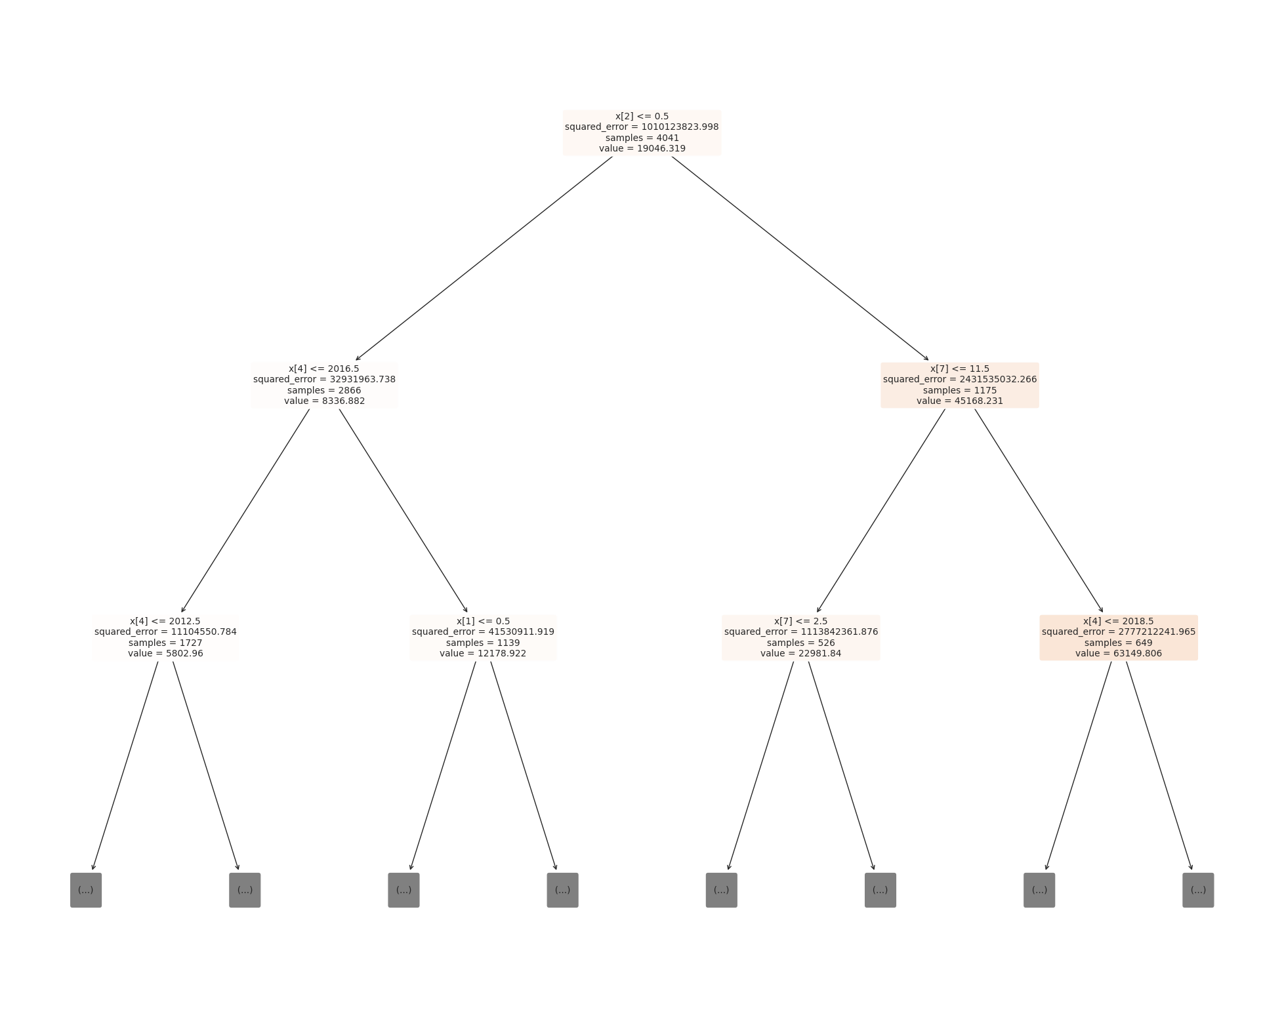
Decision Tree Regression
Most variables are categorical, a decision tree may be the best option
Decision tree taught in lectures is decision tree classifier, not suitable for continuous value such as price
Use of decision tree regressor instead, which is for continuous values
Achieve a better accuracy

Slide 13
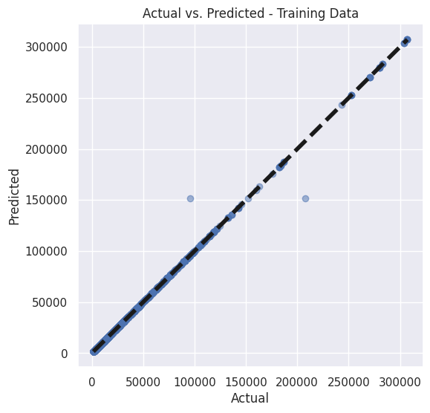
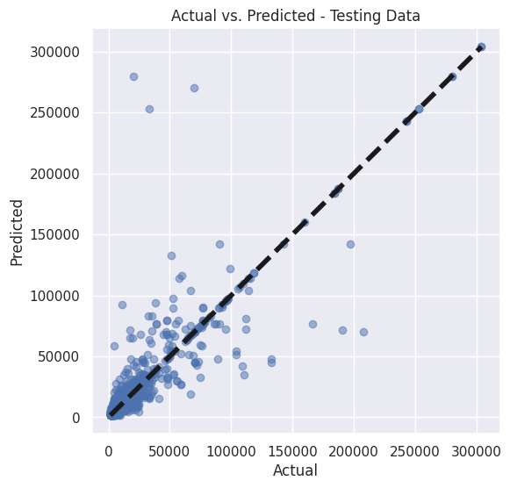
Extreme gradient boosting (XGB)
Since the use of decision tree regressor was effective, expand on it by using XGB
XGB was also good for non-linear relationships which is the case for our dataset
XGB can also handle both categorical and numerical variables, which is the case for our data
Combination of multiple decision tree is useful for our prediction
Tuning of XGB made the accuracy even better
Resulting in XGB being the best model for prediction

Slide 14

Conclusion
Possible to predict price of a used car based on variables
Manufacture year and brand will have a big impact on price of a car, which is expected
Cars with automatic transmission will sell for a higher price
XGB is the best model to predict car price
We can only predict value of the car itself, in Singapore’s context we are unable to predict COE price, which is a big factor in price of car in SG

Slide 15
Thank you!

